Slide 1
Mood boards of art styles for game
By Lenneth Dayaon

Slide 2
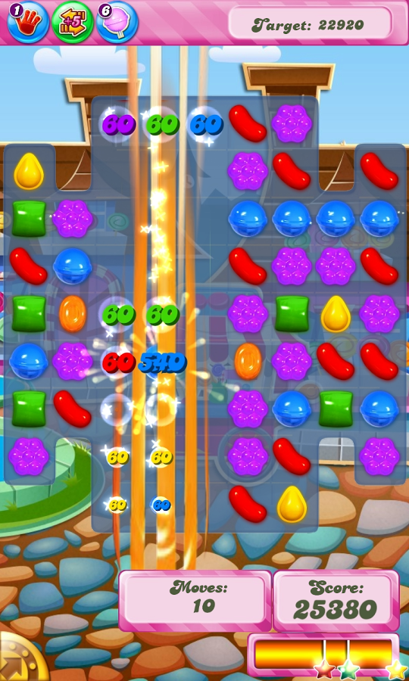
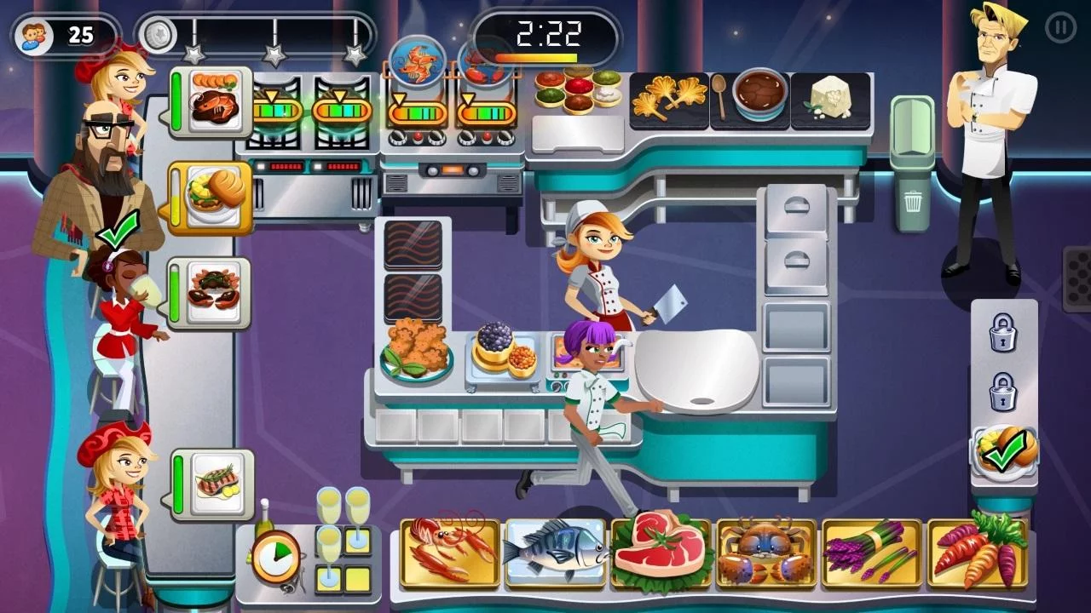
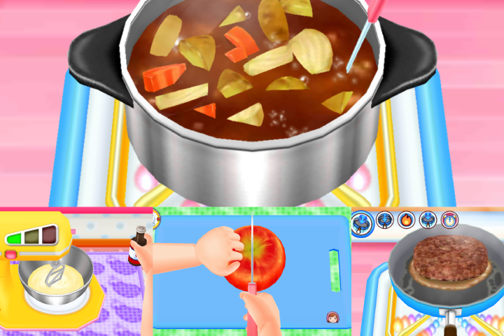
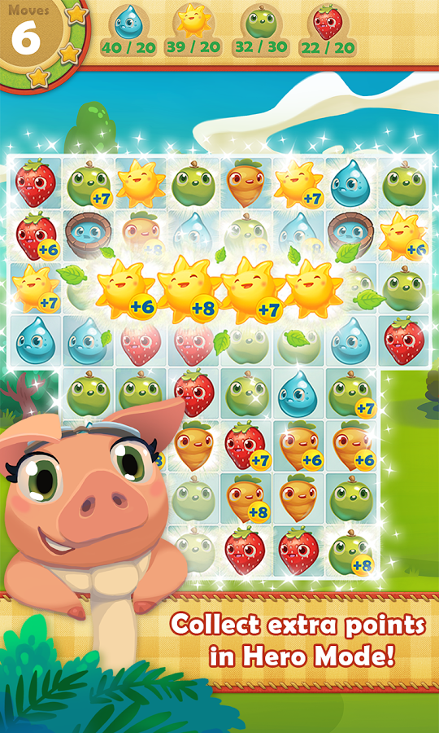

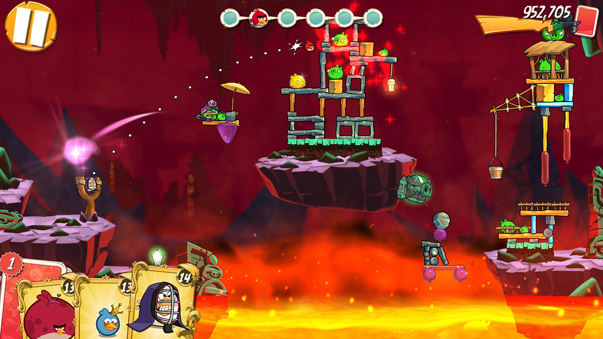

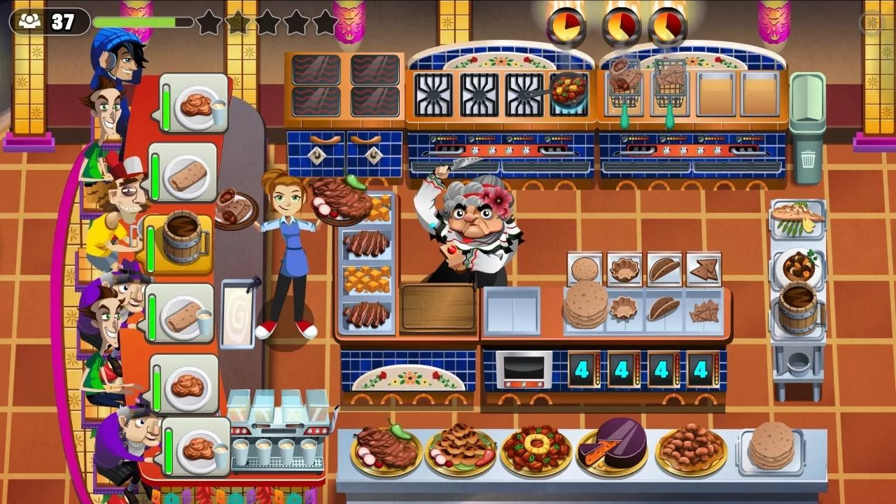
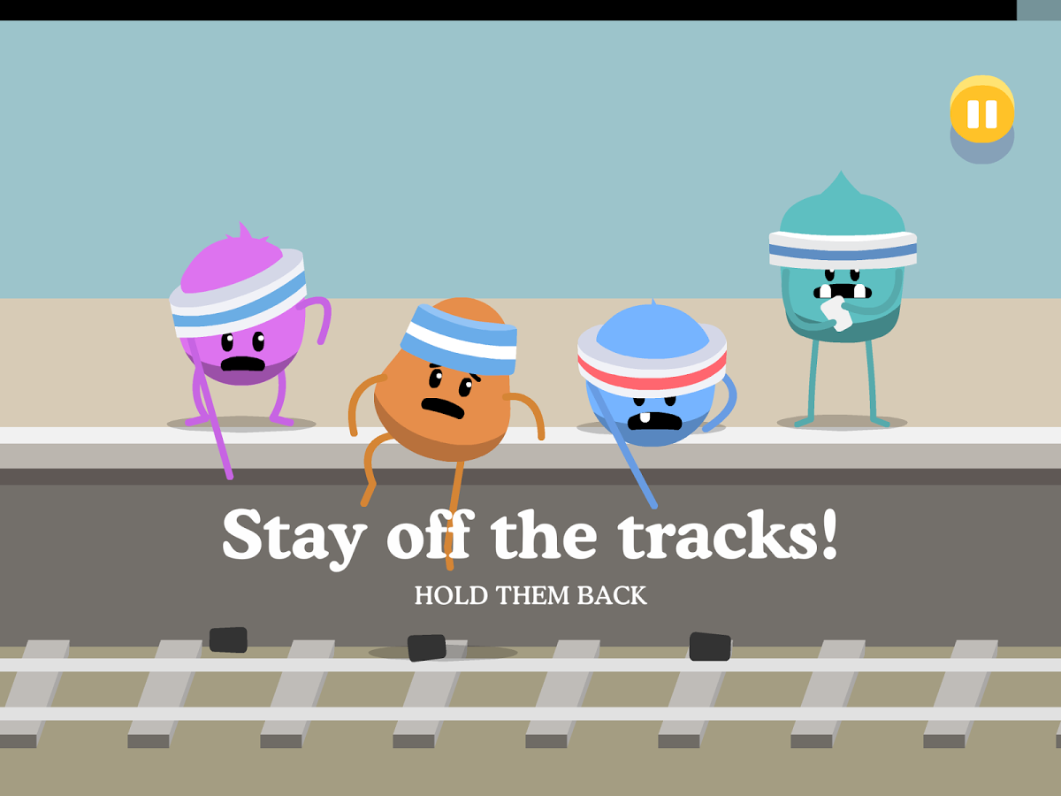

Slide 3
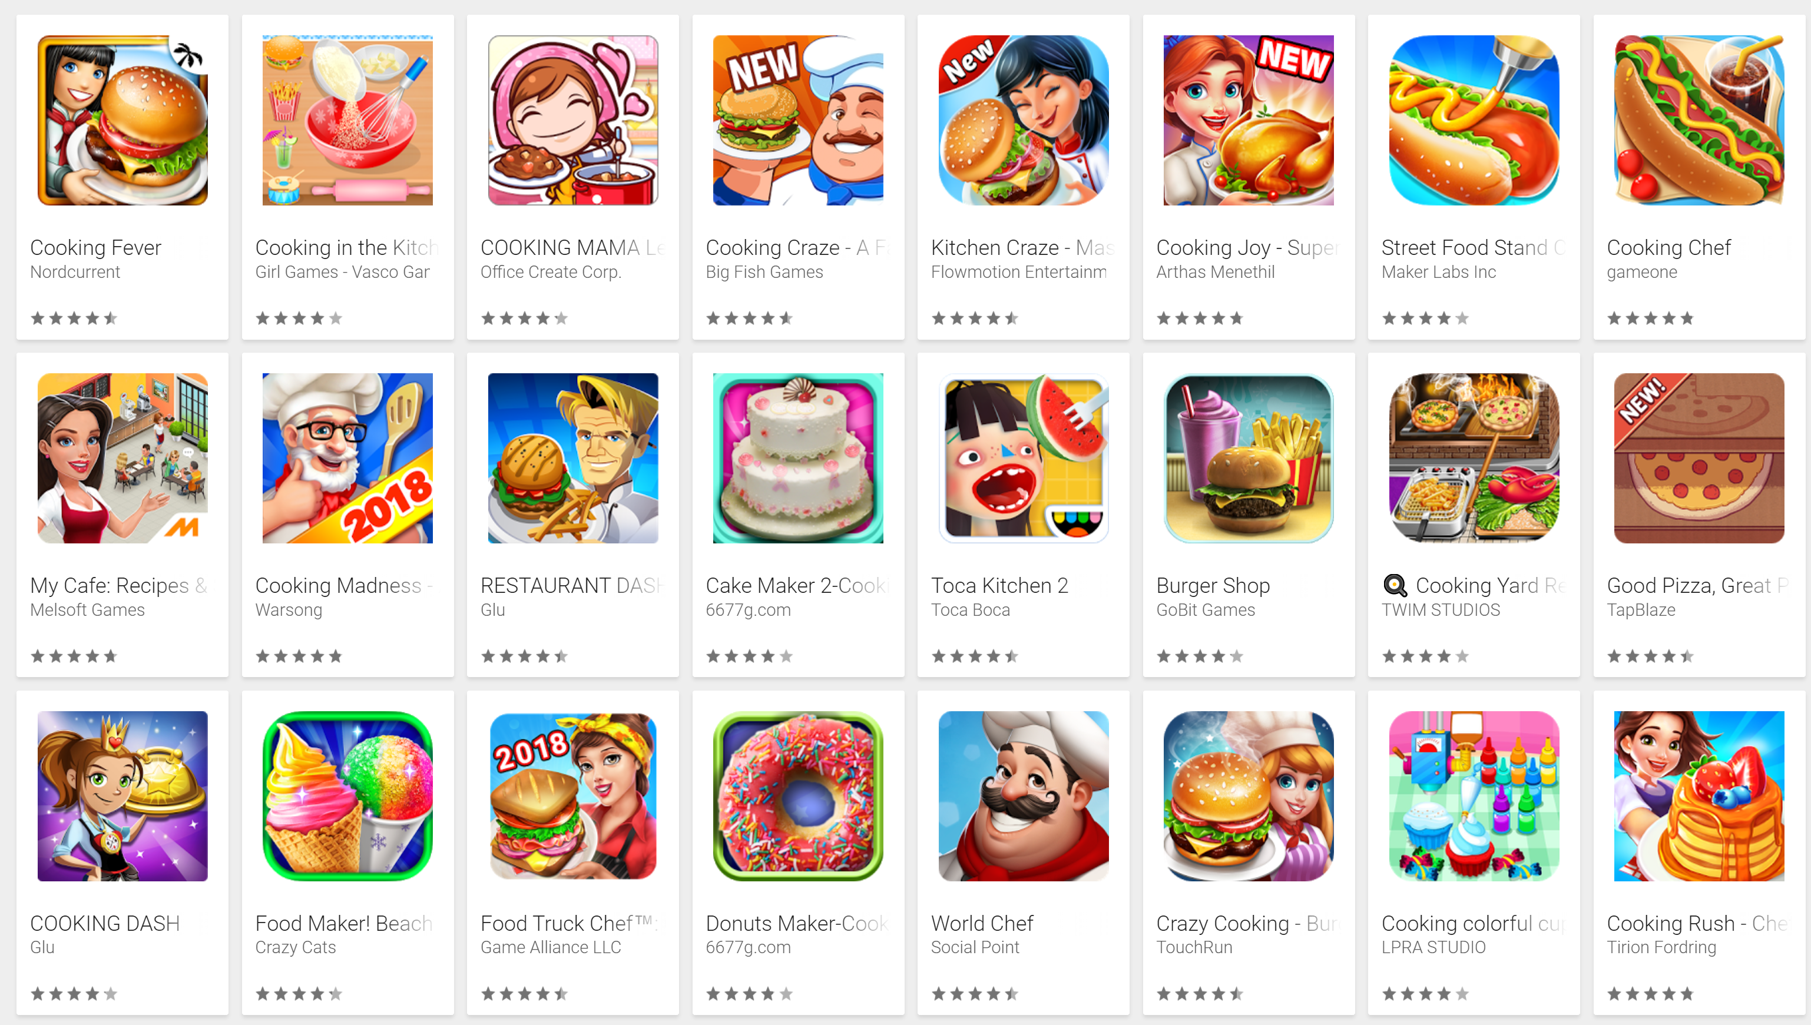
Cooking themed Games

Slide 4
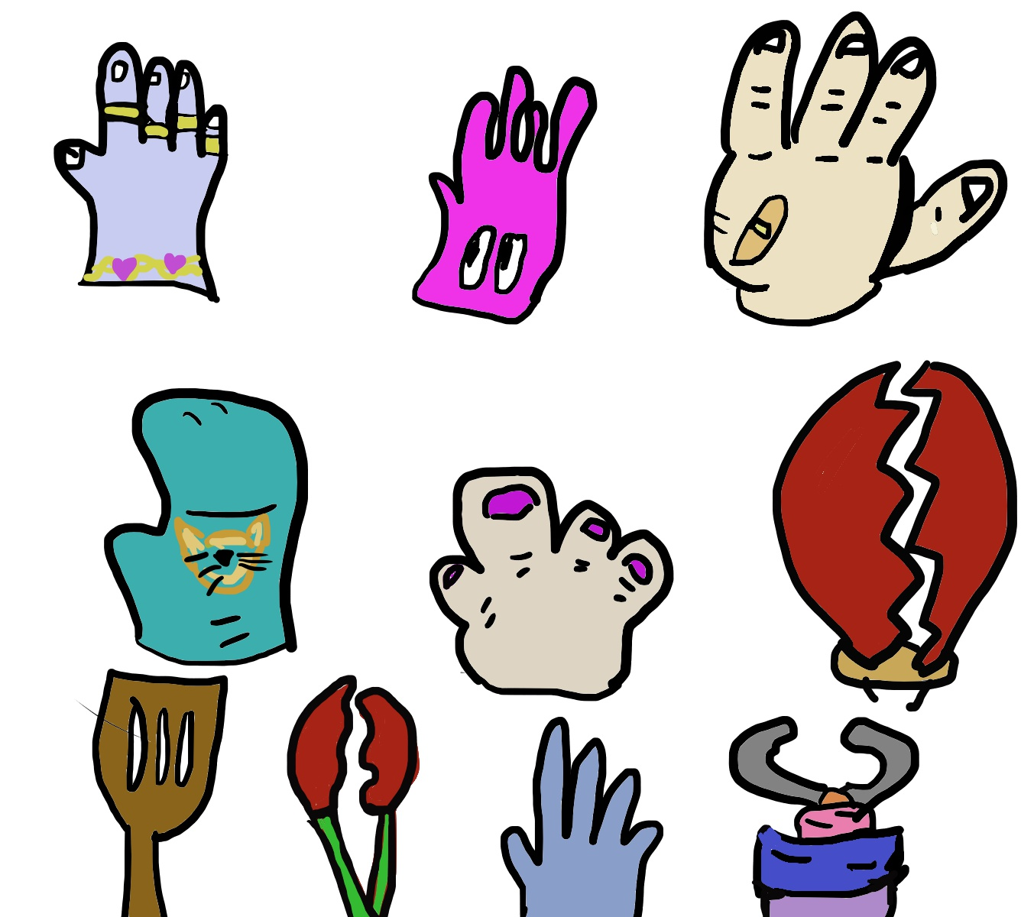
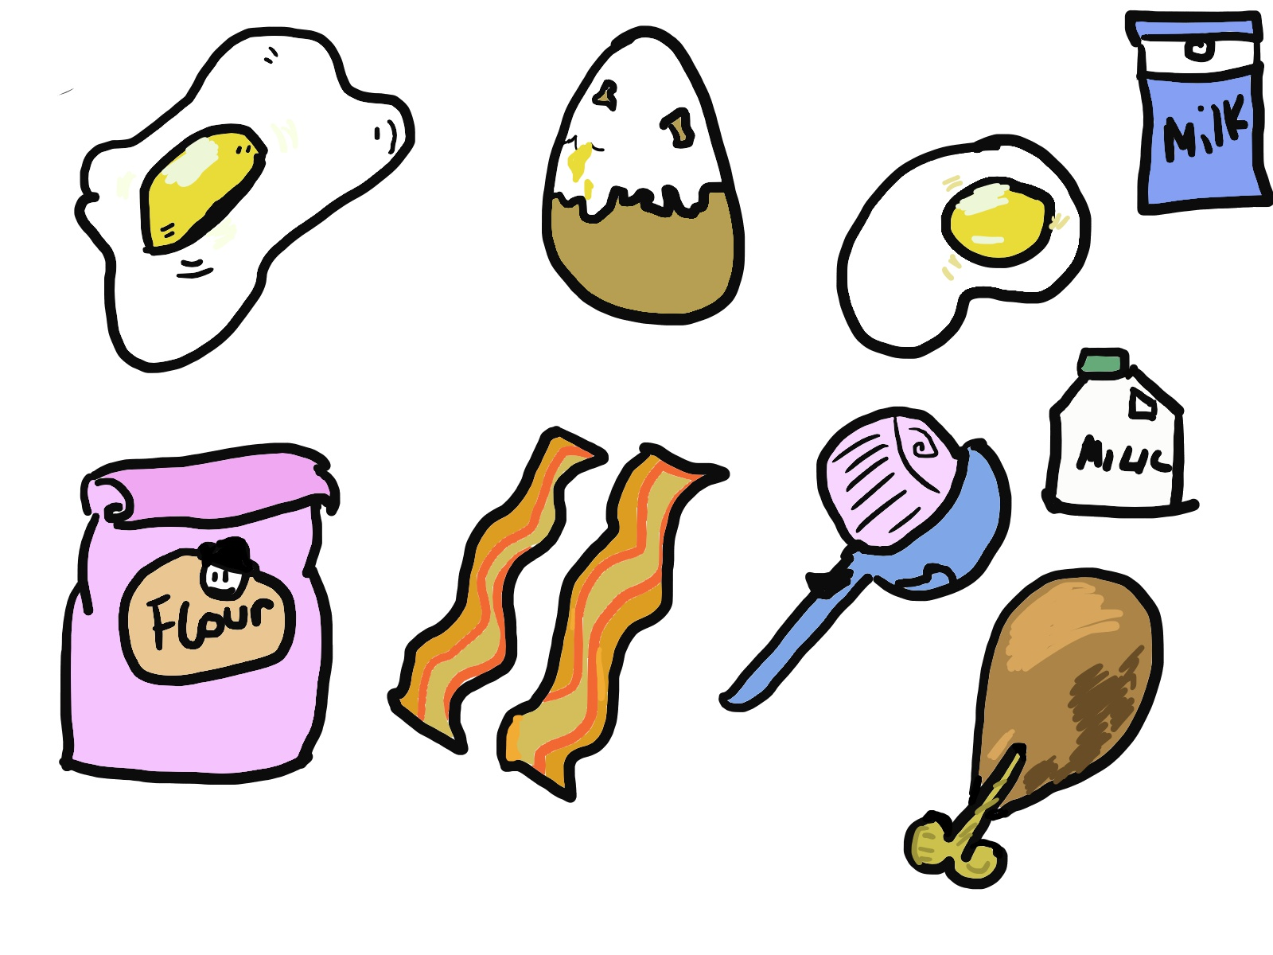
My design prototype Ideas

Slide 5
References
OfficeCreateCorp( 2nd February 2018) Cooking MAMA Let’s Cook!. Available at: https://play.google.com/store/apps/details?id=jp.co.ofcr.cm00 (Accessed: 04/02/2018)
Glu(16th November, 2017) Restaurant Dash: Gordon Ramsey. Available at: https://play.google.com/store/apps/details?id=com.glu.gordondashx (Accessed: 04/02/2018)
Glu(9th January, 2018) Cooking Dash. Available at: https://play.google.com/store/apps/details?id=com.playfirst.cookingdashx(Accessed: 04/02/2018)
TirionFordring(26th January, 2018) Cooking Rush – Che’s Fever Games. Available at: https://play.google.com/store/apps/details?id=com.bigbang.cookingrush(Accessed: 04/02/2018)
King (17th January, 2018) Candy Crush Saga. Available at:https://play.google.com/store/apps/details?id=com.king.candycrushsaga (Accessed: 04/02/2018)
King(30th January, 2018) Farm Heroes Saga. Available at: https://play.google.com/store/apps/details?id=com.king.farmheroessaga (Accessed: 04/02/2018)
MetroTrains(23rd January, 2018) Dumb Ways to Die 2: The Games. Available at: https://play.google.com/store/apps/details?id=air.au.com.metro.DumbWaysToDie2Accessed: 04/02/2018)
EpisodeInteractive(31st January 2018) Episode – Choose your story. Available at: https://play.google.com/store/apps/details?id=com.episodeinteractive.android.catalog&hl=en_GB (Accessed: 04/02/2018)
Rovio Entertainment Corporation(22nd January, 2018) Angry Birds 2. Available at: https://play.google.com/store/apps/details?id=com.rovio.baba (Accessed: 04/02/2018)
GooglePlay (2018) Cooking Games. Available at: https://play.google.com/store/search?q=cooking&c=apps&hl=en_GB (Accessed: 04/02/2018)

